Slide 1
Software Defined Networks and the
Maturing of the Internet
Nick McKeown
Stanford University

Slide 2



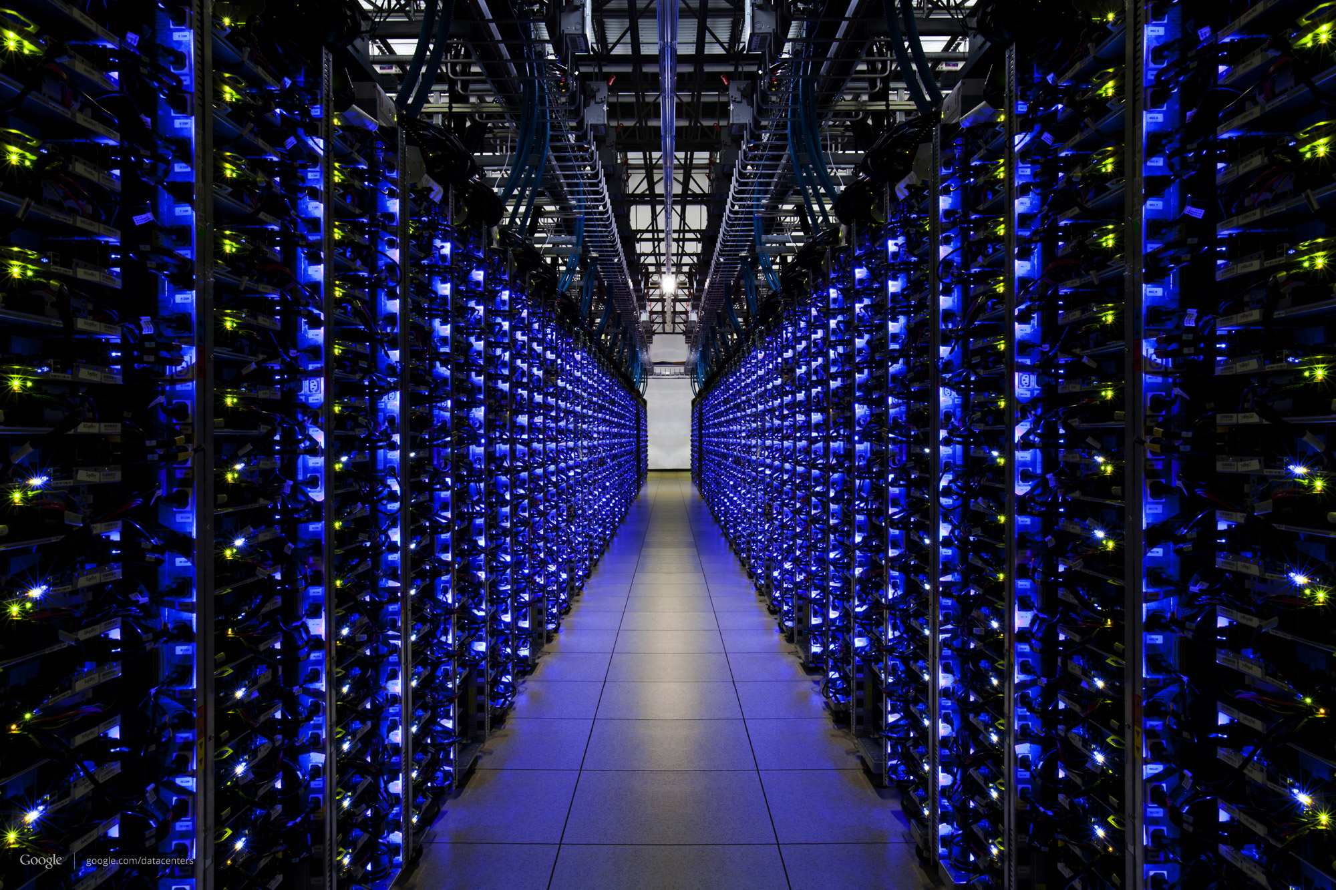
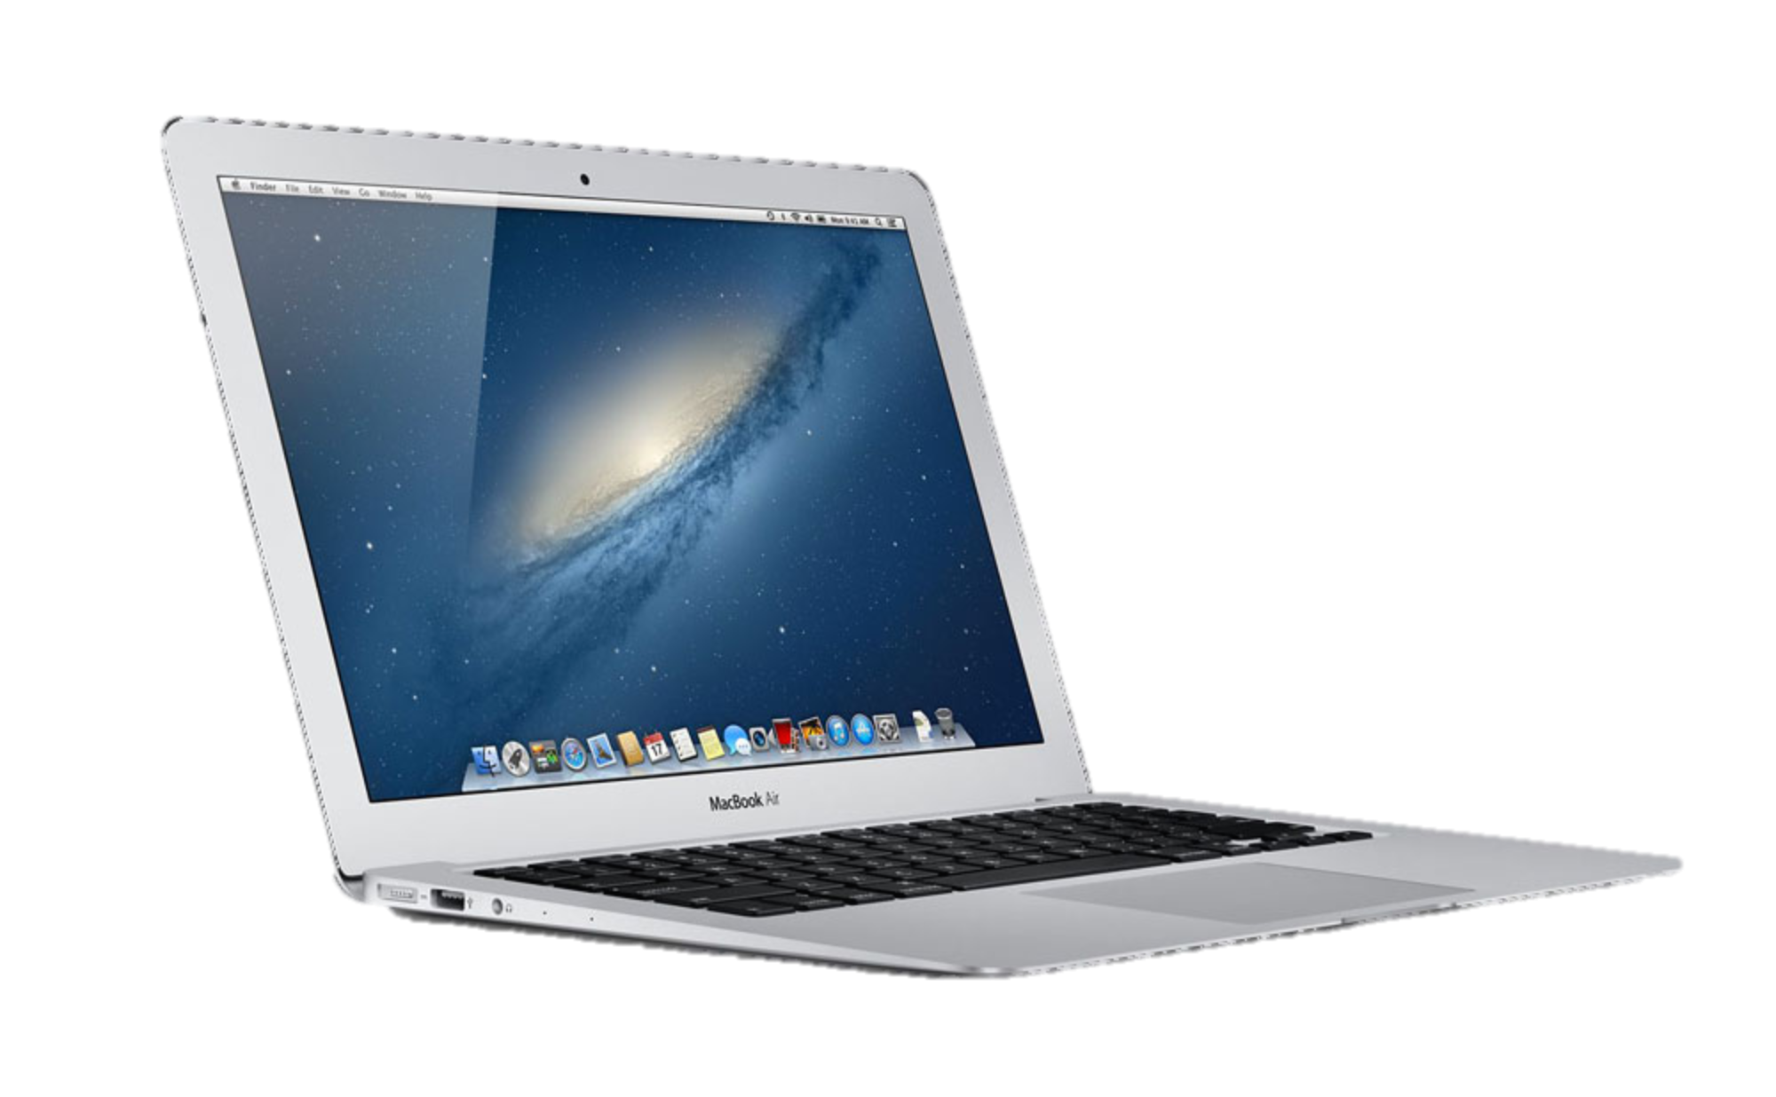
Notes:
Recently you will have heard the Internet is 20 years old…..
When you think of the Internet, you probably think about how you use it, such as using Google to search for information, Facebook to stay in touch with friends, and Netflix or YouTube to watch videos. At some level you are probably aware that the data is coming to you from some distant warehouse full of computers <click> in a series of packets <click>.
But today I won’t be talking about the applications and services we use on top of the Internet. I’m talking about the Internet itself. The Internet infrastructure, the invisible layer of plumbing that sits underneath the applications we all use. It is a sign of the success of the Internet that we don’t normally think about how it works – it’s invisible. We don’t normally think how the water flows through the plumbing when we let the plug out of the bath or flush the toilet. Nor should we need to think about how packets flow and are controlled.
But if we are to understand how the Internet is changing and maturing, we need to think about how data flows, and the decisions people made about how it works. We call these decisions the architectural principles of the Internet, and I’ll be coming to them shortly.
So just for today, we’re going to make the Internet plumbing a first class citizen….

Slide 3
Why was an Internet so simple and dumb so successful?
Notes:
You may be wondering why the Internet designed this way.
Why was an Internet so SIMPLE, DUMB and UNRELIABLE so successful?

Slide 4
The Internet was successful because it was simple and dumb
Notes:
Today it’s pretty widely accepted that the internet was successful precisely BECAUSE it was SIMPLE, DUMB and UNRELIABLE!
So how can that be?

Slide 5
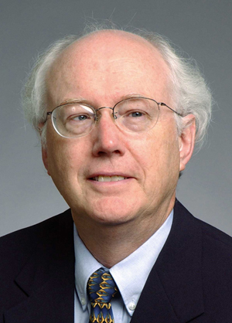
David D. Clark
Chief Protocol Architect, Internet
1981 - 1989

Slide 6
Architectural Principles
1
Dumb and simple
i
Streamlined, fast, low-cost, easy to maintain, infrequent upgrades.
Reliable in-order delivery can be built on top, at the end-points.
i
Intelligent end-points (computers).
2

Slide 7
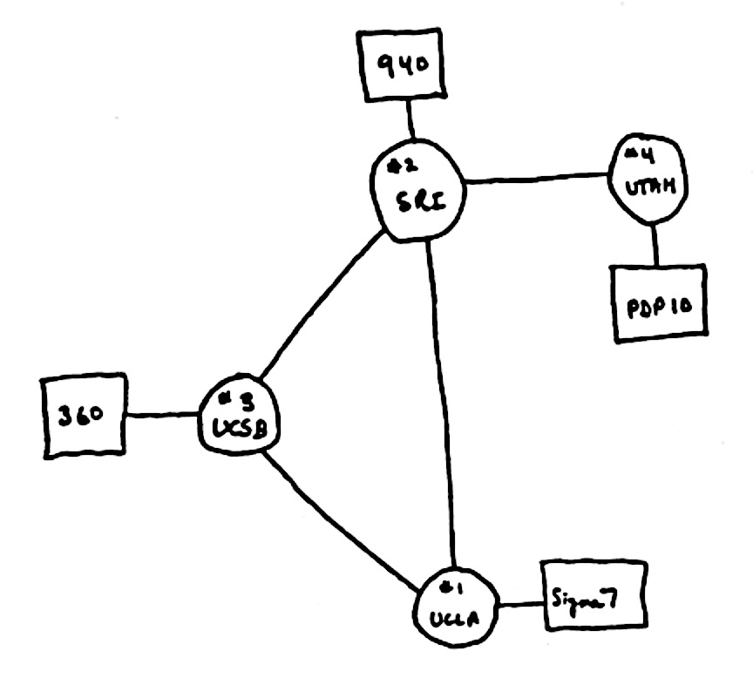
Architectural Principles
3
Decentralized control
i
Rapid organic growth
1969
Notes:
: Four nodes
UCLA, SRI, UCSB, Utah.

Slide 8
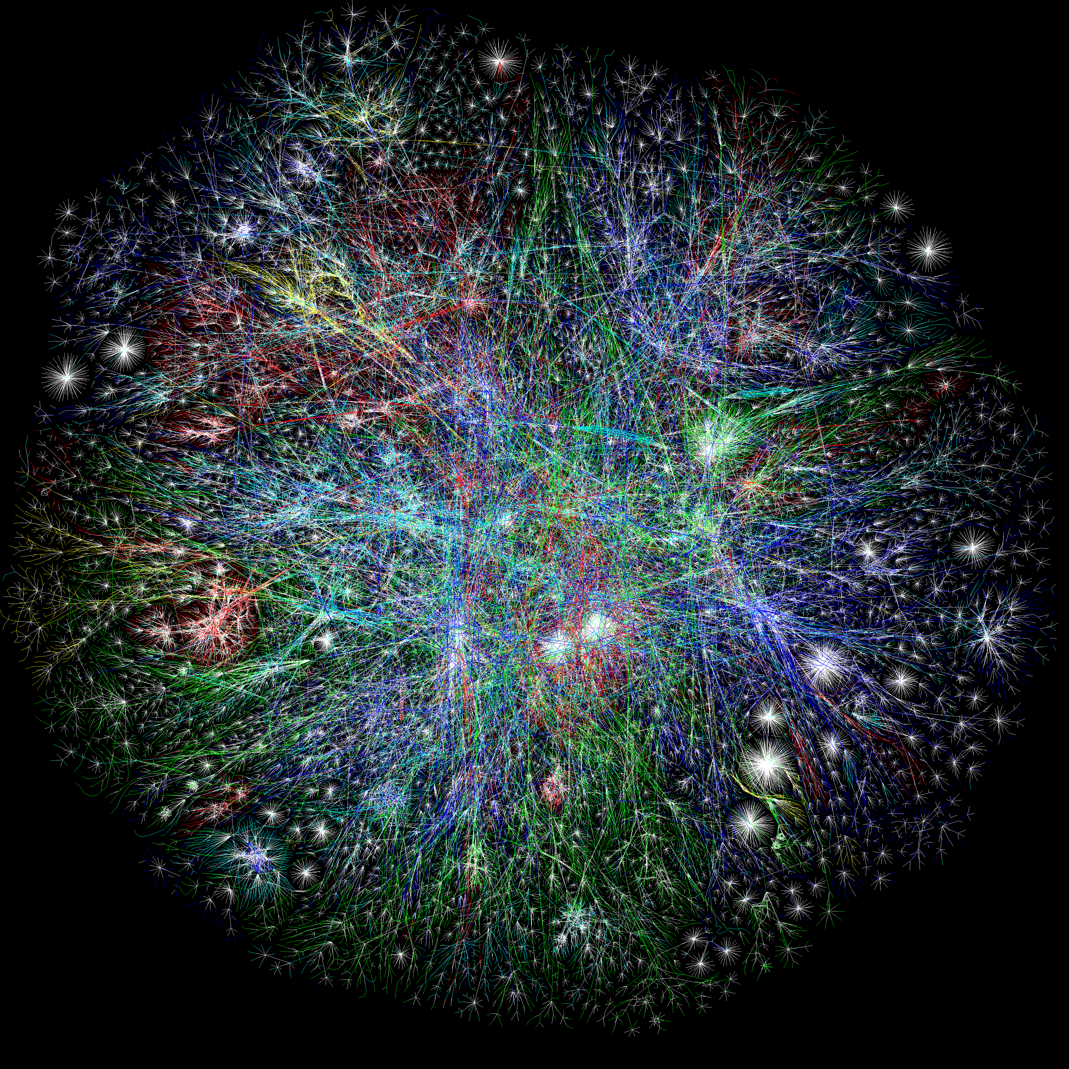
The Opte Project
Notes:
Clearly this is way beyond something a human can do in their head. (Well, me at least – maybe you can).
So we need automated algorithms to calaculate the route and put the necessary fwding entries into the forwarding tables in the routers.
To calculate the routes, the routers will exchange information with each other about the current topology.
This is the job of what we call the Routing Algorithm or the Routing Protocol.
In some cases, the algorithm to calculate the route is wrapped in with the exchange of the state. In other cases, they are separate.
WE will look at both.

Slide 9
Computers connected to Internet
1 Billion
Millions
Source: ISC

Slide 10
The Internet was deliberately designed …
simple and streamlined
To be simple and streamlined.
To have decentralized control: Lots of individually controlled pieces.
Which led to …
Explosive organic growth of the Internet.
A great business for companies selling routers.
A great business
Notes:
About $100B per year. 70% gross profit margin. Which means for every $100 of goods sold, they cost $30 to build. Not bad.
There is a business paradox here. Or rather, the situation is not stable: Simple and Streamlined is at odds with “A great business” <click>
There are two ways to break the instability: Either the Internet becomes a simple and streamlined commodity and is not particularly profitable. This would have been the social good.
Or, we break the simple and streamlined to justify keeping the profit margins high, and keeping others out of the business.
Which would you do if you had a very successful, great business?

Slide 11
Number of published Internet Standards
Notes:
First one published April 7, 1969
Many of these are written and published by the router companies themselves…..

Slide 12
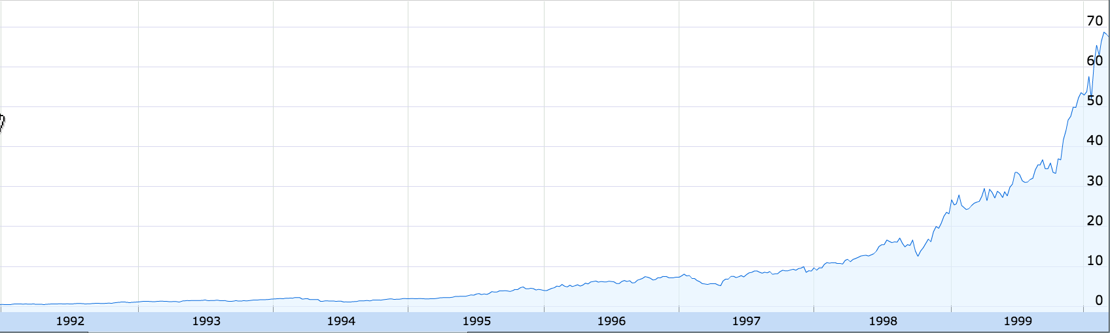
Cisco Stock Price
200x
1991
1999
Google Finance

Slide 13
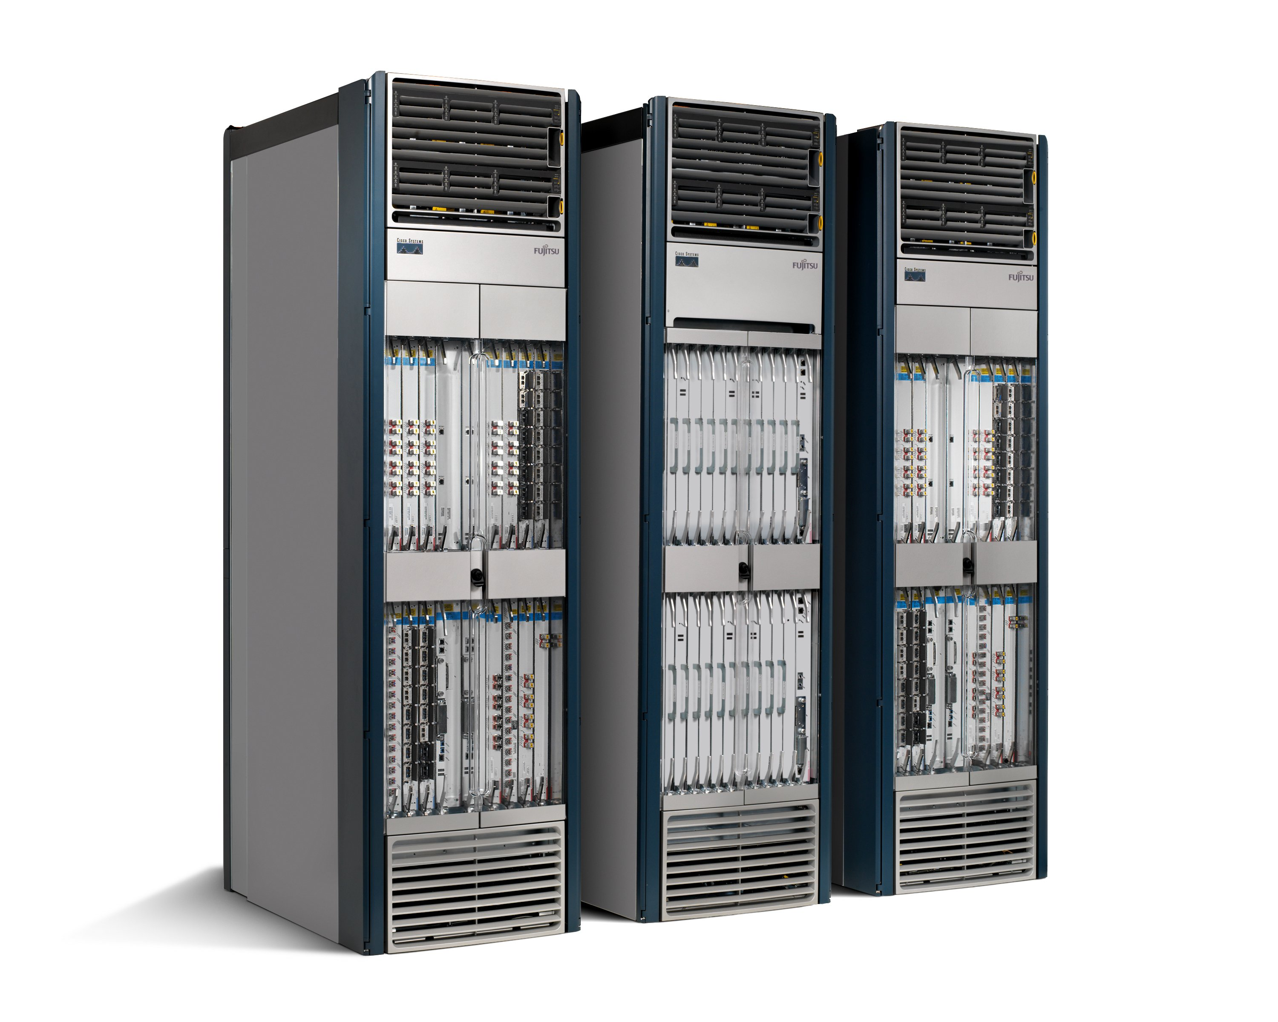
50+ million lines of code
Software
Tens of billions of gates
Hardware
Routers are fragile, insecure, bloated and power hungry
Like the computer mainframes of the 1980s.
“Great business” triumphed over “simple and streamlined”.
Notes:
The consequence: Routers bloated, expensive, fragile and insecure….
We can argue about the details; but it couldn’t be any other way, because the market is making it so.
So what to do?

Slide 14
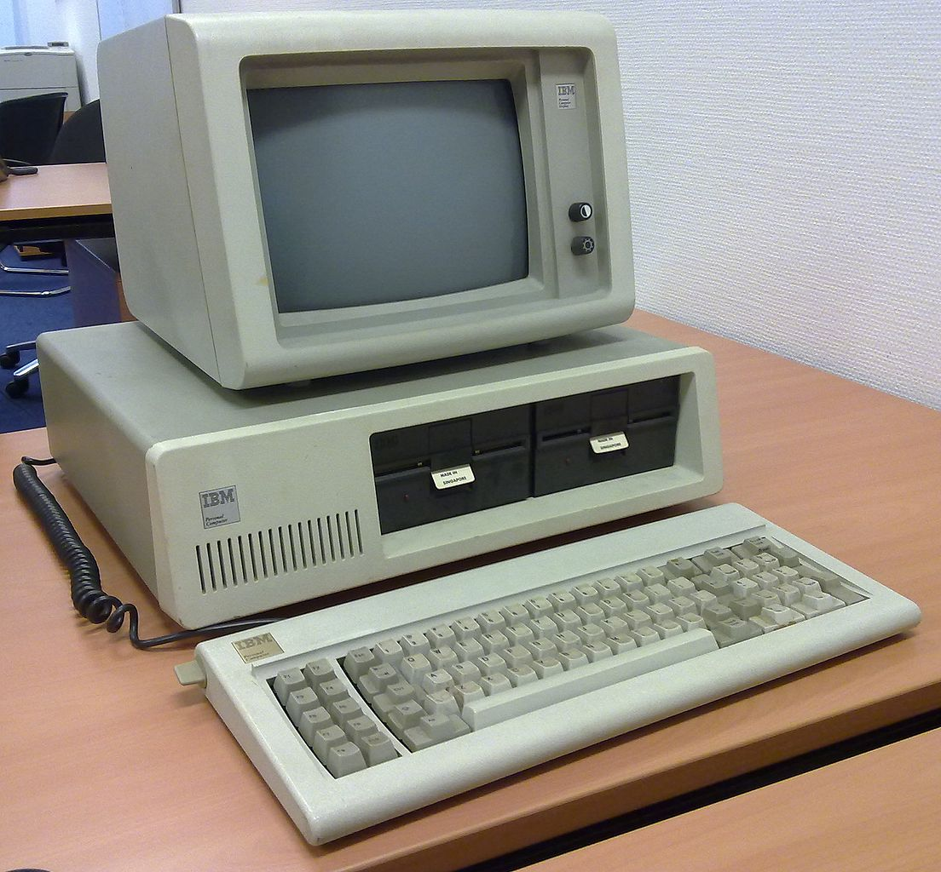
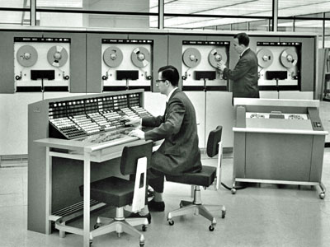
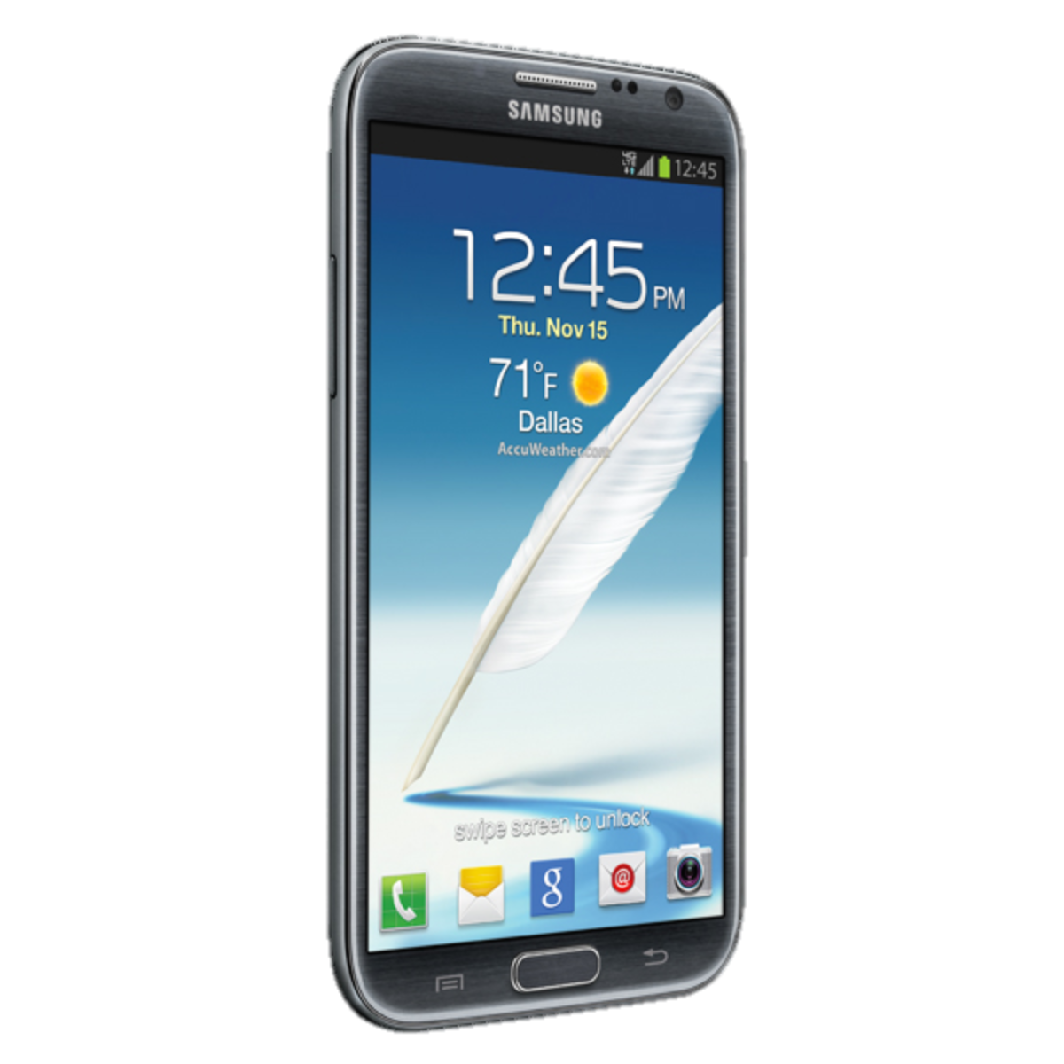
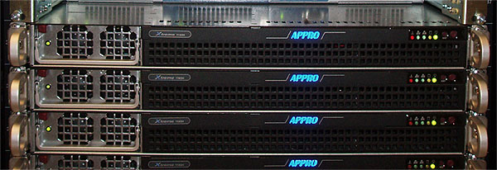
Computers became easier to use and more reliable…
2000s
1960s
Now
1980s
2000s
1960s
Now
1980s

Slide 15
Making Software Work
Specification
$10B tool business
supports a
$300B S/W industry
Functional Description (Code)
Testbench
Static Code Analysis
Invariant
Checker
Model Checking
100s of Books
>100,000 Papers
10s of Classes
Run-time Checker
Interactive Debugger

Slide 16
Networks became harder to manage and less reliable…
Now
Now

Slide 17
Making Networks Work (Today)
traceroute, ping, tcpdump, SNMP, Netflow
…. er, that’s about it.

Slide 18
Networks are kept working by
“Masters of Complexity”
A handful of books
Almost no papers
No classes

Slide 19
What this means for people who own large networks

Slide 20
Example 1: Internet Service Providers
Global IP traffic growing 40-50% per year
End-customer monthly bill remains unchanged
Therefore, cost of ownership needs to reduce 40-50% per Gb/s per year
But in practice, reduces by <20% per year
Revenue
£20/month
Total cost
Growth in traffic
time

Slide 21

Example 2: Data Center Owner
Cost
400,000 servers
20,000 switches
$5k per switch = $100M
$1k commodity switch = $20M
Savings in 10 data centers = $800M
Control
More flexible control
Tailor network as needed
Quickly improve and innovate

Slide 22
Sidebar: Lessons from the computer industry

Slide 23
Hardware

Slide 24
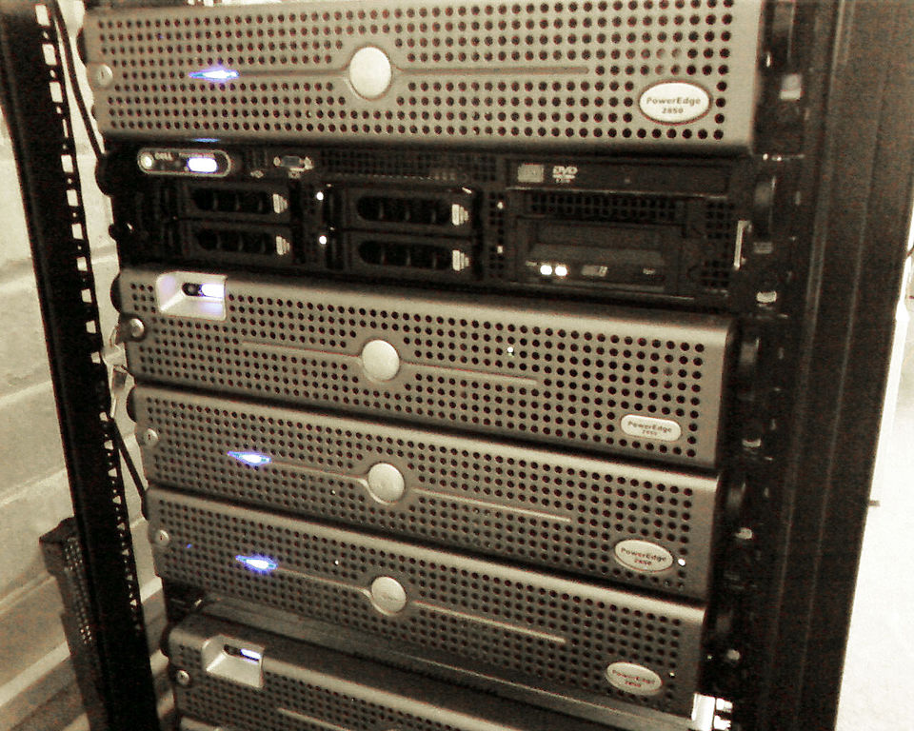
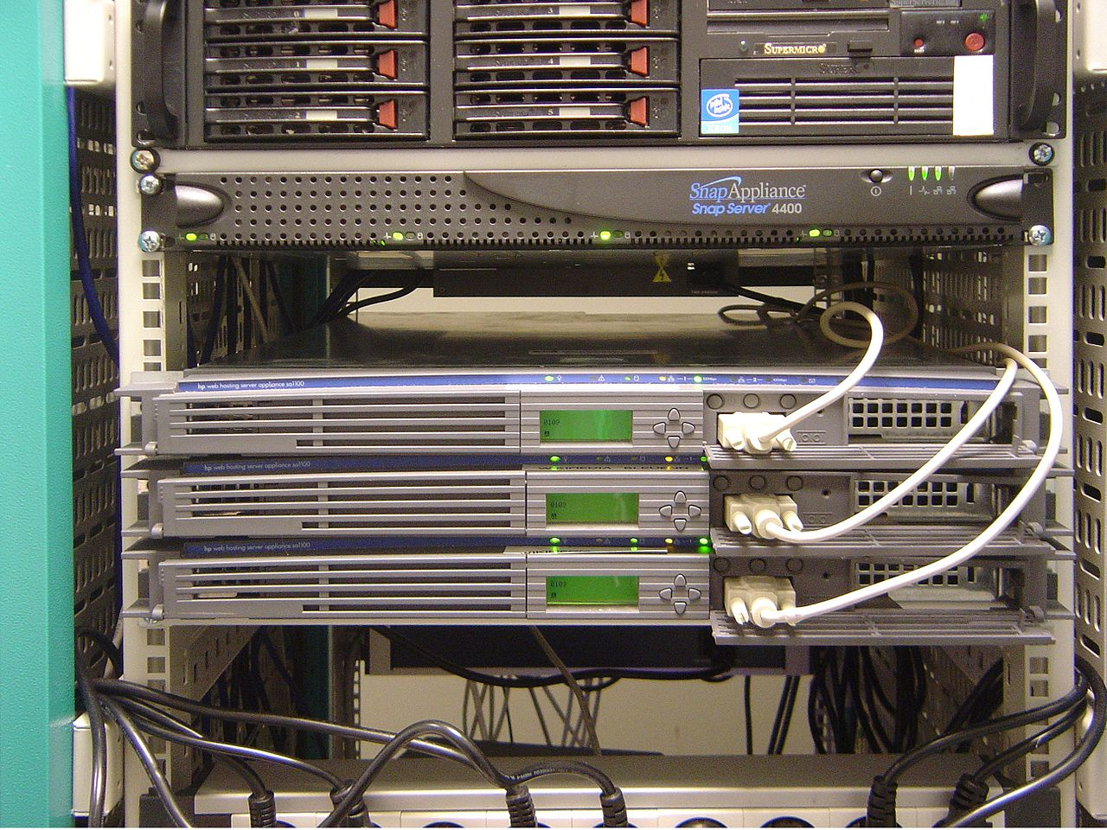
2000: Rack-mounted Servers
Dell Servers
HP Servers

Slide 25
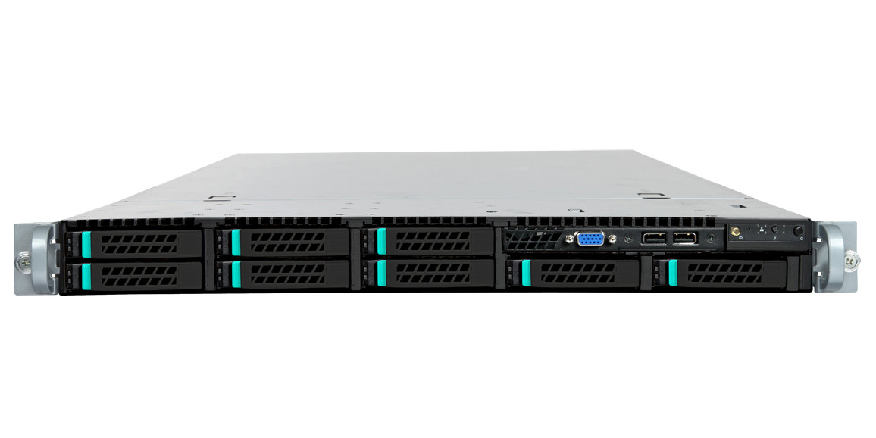

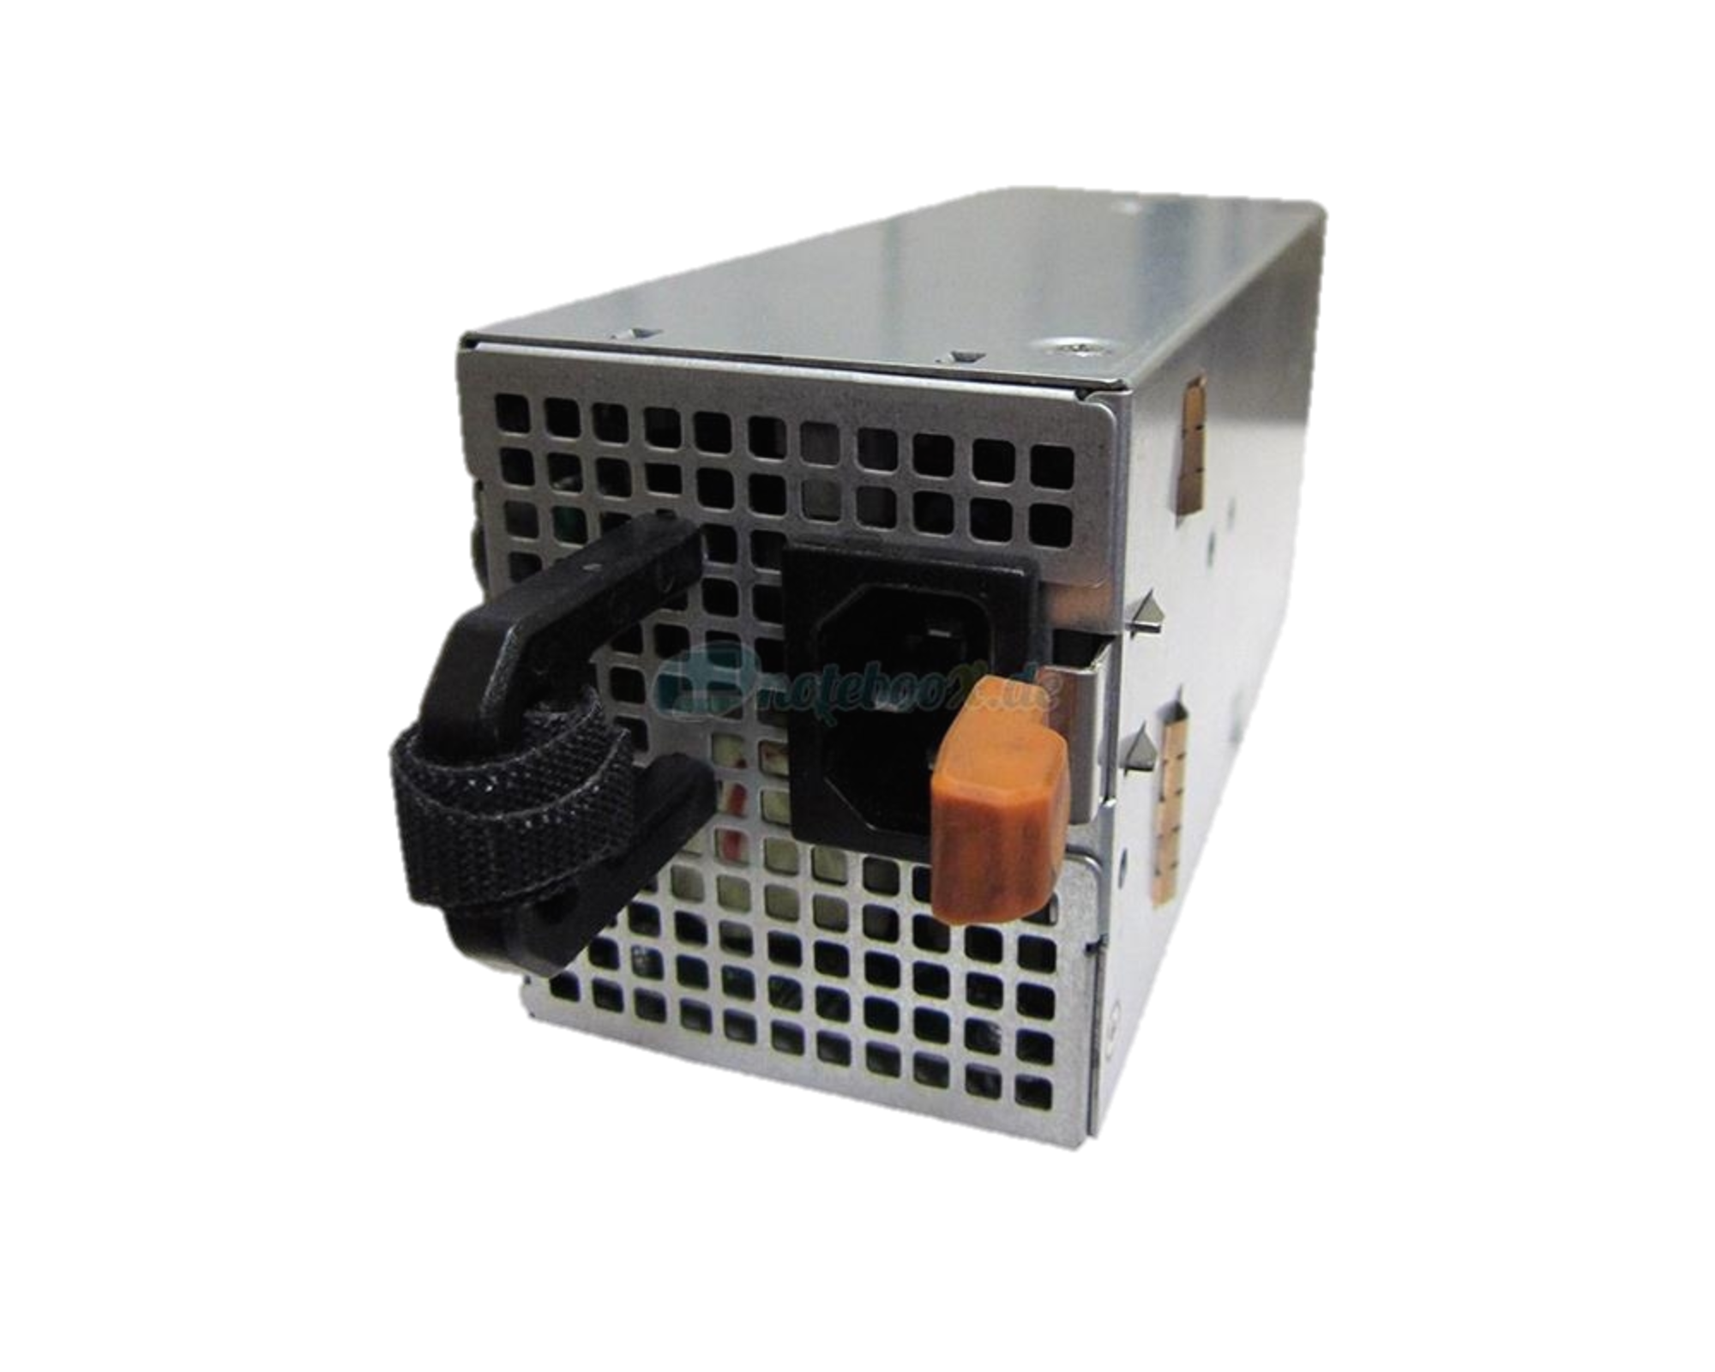
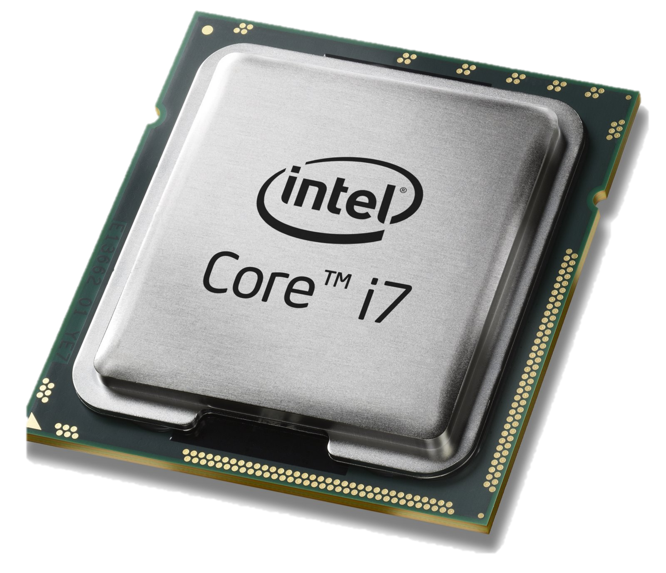
2005: The whitebox server
Sheet metal
DRAM
Notes:
2.5Billion transistors --- 100,000 times bigger. 4GHz --- 10,000 times faster
Taiwan

Slide 27
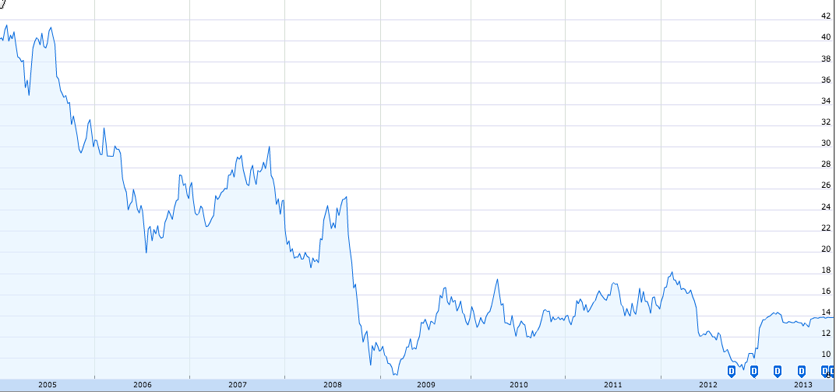
Dell Stock Price
$42
$14
2005
2013
Google Finance

Slide 28
Software

Slide 29
“Software will eat the world”
Marc Andreessen

Slide 30
Software in 2014
Smartphone: Open 75%, Closed 25%
Browser: Open 63%, Closed 37%
Websites: Open 67%, Closed 33%
DC servers: Open 70%, Closed 30%
Tablet: Open 62%, Closed 38%
Mainframes: Open 60%, Closed 40%
Supercomputers: Open 99%
Open-source still growing fast

Slide 31
CPU + Linux + Application
App
App
App
Proprietary
Software
Linux
Open Source
Software
Sheet metal
Programmable
Hardware
DRAM
Notes:
2.5Billion transistors --- 100,000 times bigger. 4GHz --- 10,000 times faster
Taiwan

Slide 32
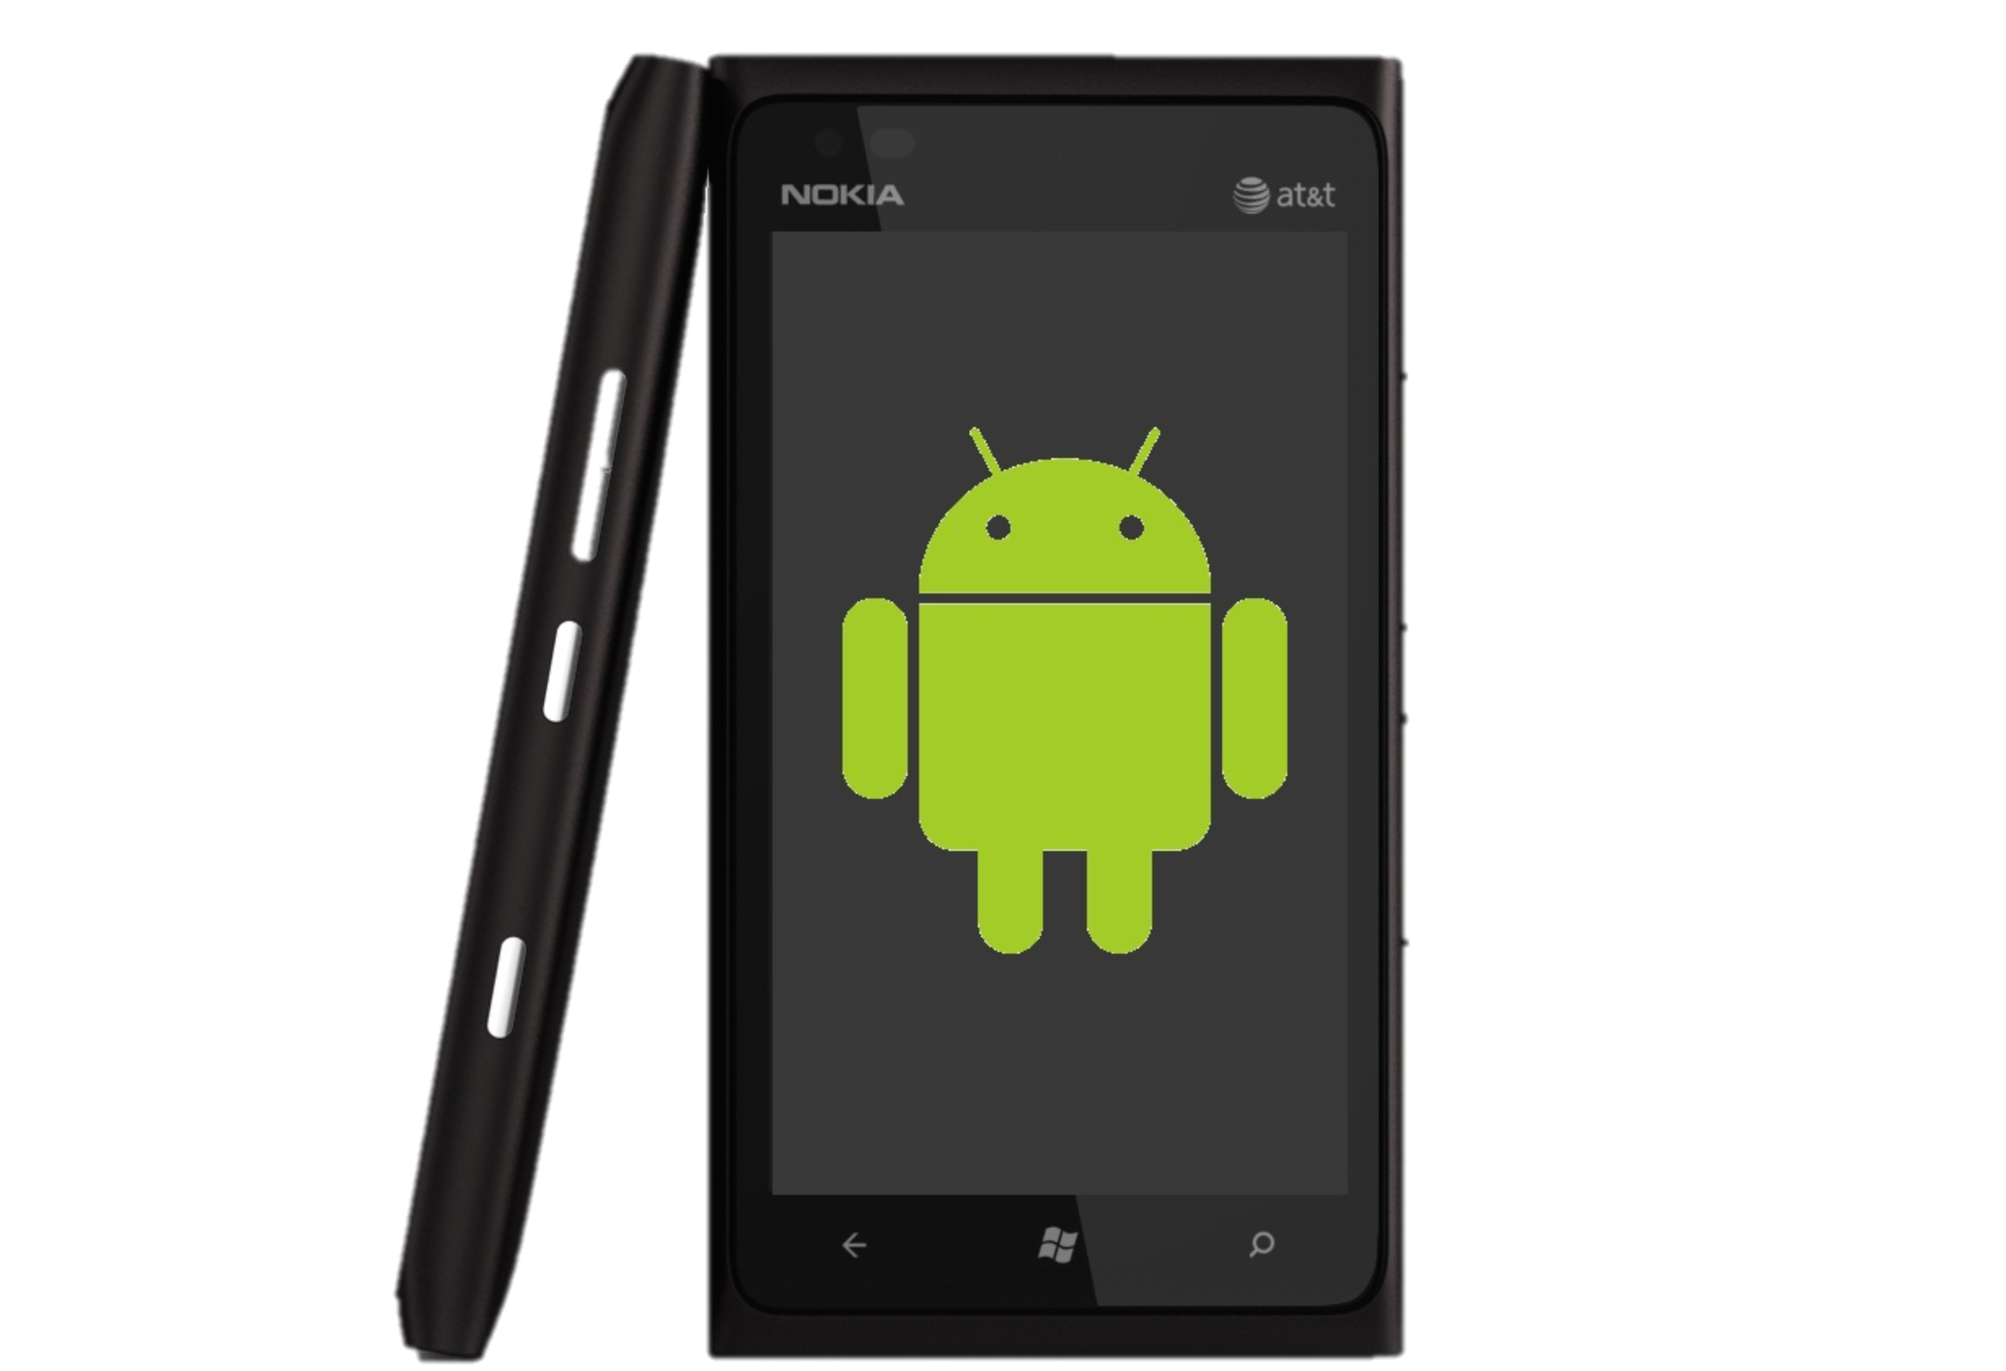

CPU + Linux + Application
Baremetal
xChip/x86 + Linux/BSD
Public Internet
Telcos/Cable
ARM + Linux
Open
Connect
Netflix
Compute:
Baremetal
x86 + Linux
(10 million/yr)
YouTube
Google Fiber
B4
Facebook
Google WiFi
Network:
Baremetal
xChip/x86 + Linux
(500 thousand/yr)
Search
Swan
Amazon

Slide 33
(End of Sidebar: Lessons from the computer industry)

Slide 34
SDN: What just happened?
Rise of Linux.
Rise of merchant switching silicon.

Slide 35
Cisco 2014
#1 competitor = software company (VMware)
#1 fear = bare-metal switches
IBM, Compaq, Dell run Linux
Android Linux
>75% new smartphones
Google incorporated
Virtual Ethernet ports
> Physical ports
Linux v1
v2
1st xChip +
Linux DC
1st xChip +
Linux WAN
OVS
OCP
Server
OCP
Switch
OCP
Wedge
ONIE
ONL
Rise of Switch Chips (“xChips”)
ODL
ONOS
NSX
OpenNFV
1994
1996
1998
2008
2010
2011
2012
2013
2014

Slide 36
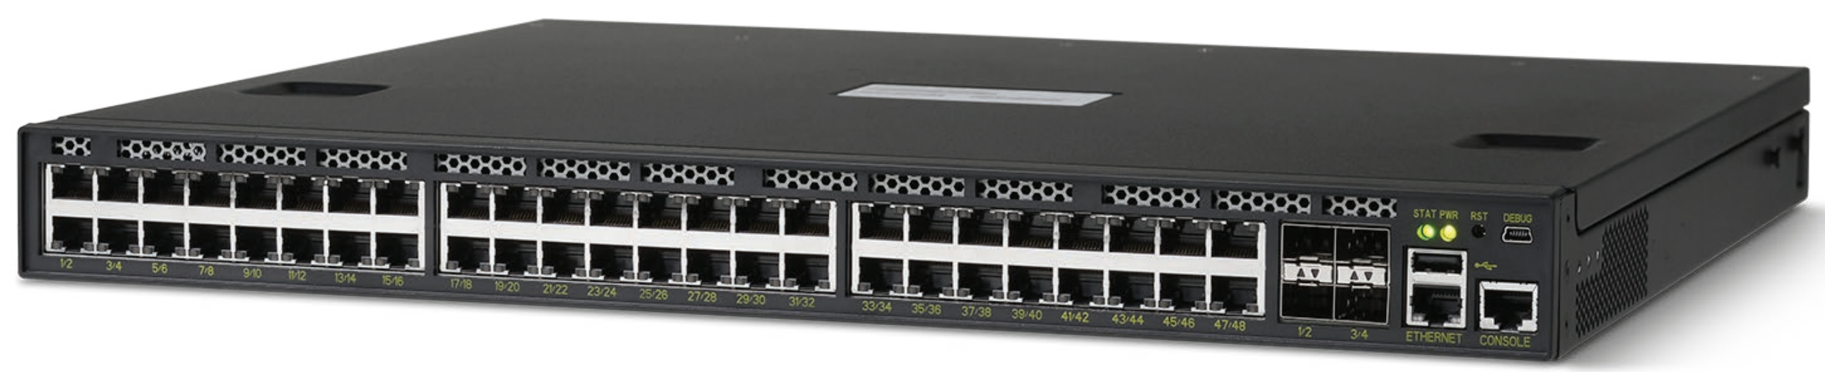
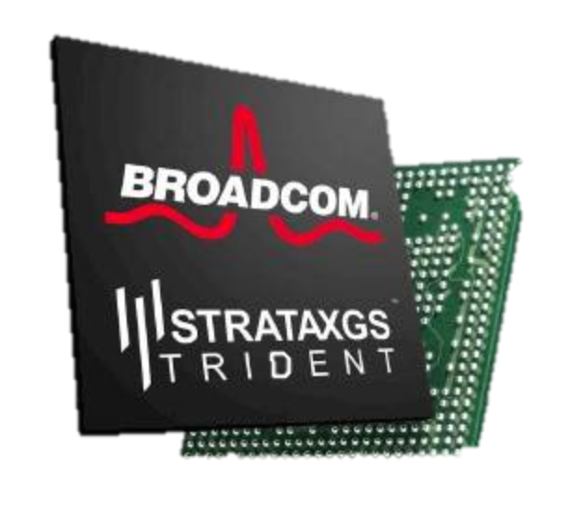
The bare-metal switch
Sheet metal
DRAM
xChip

Slide 37
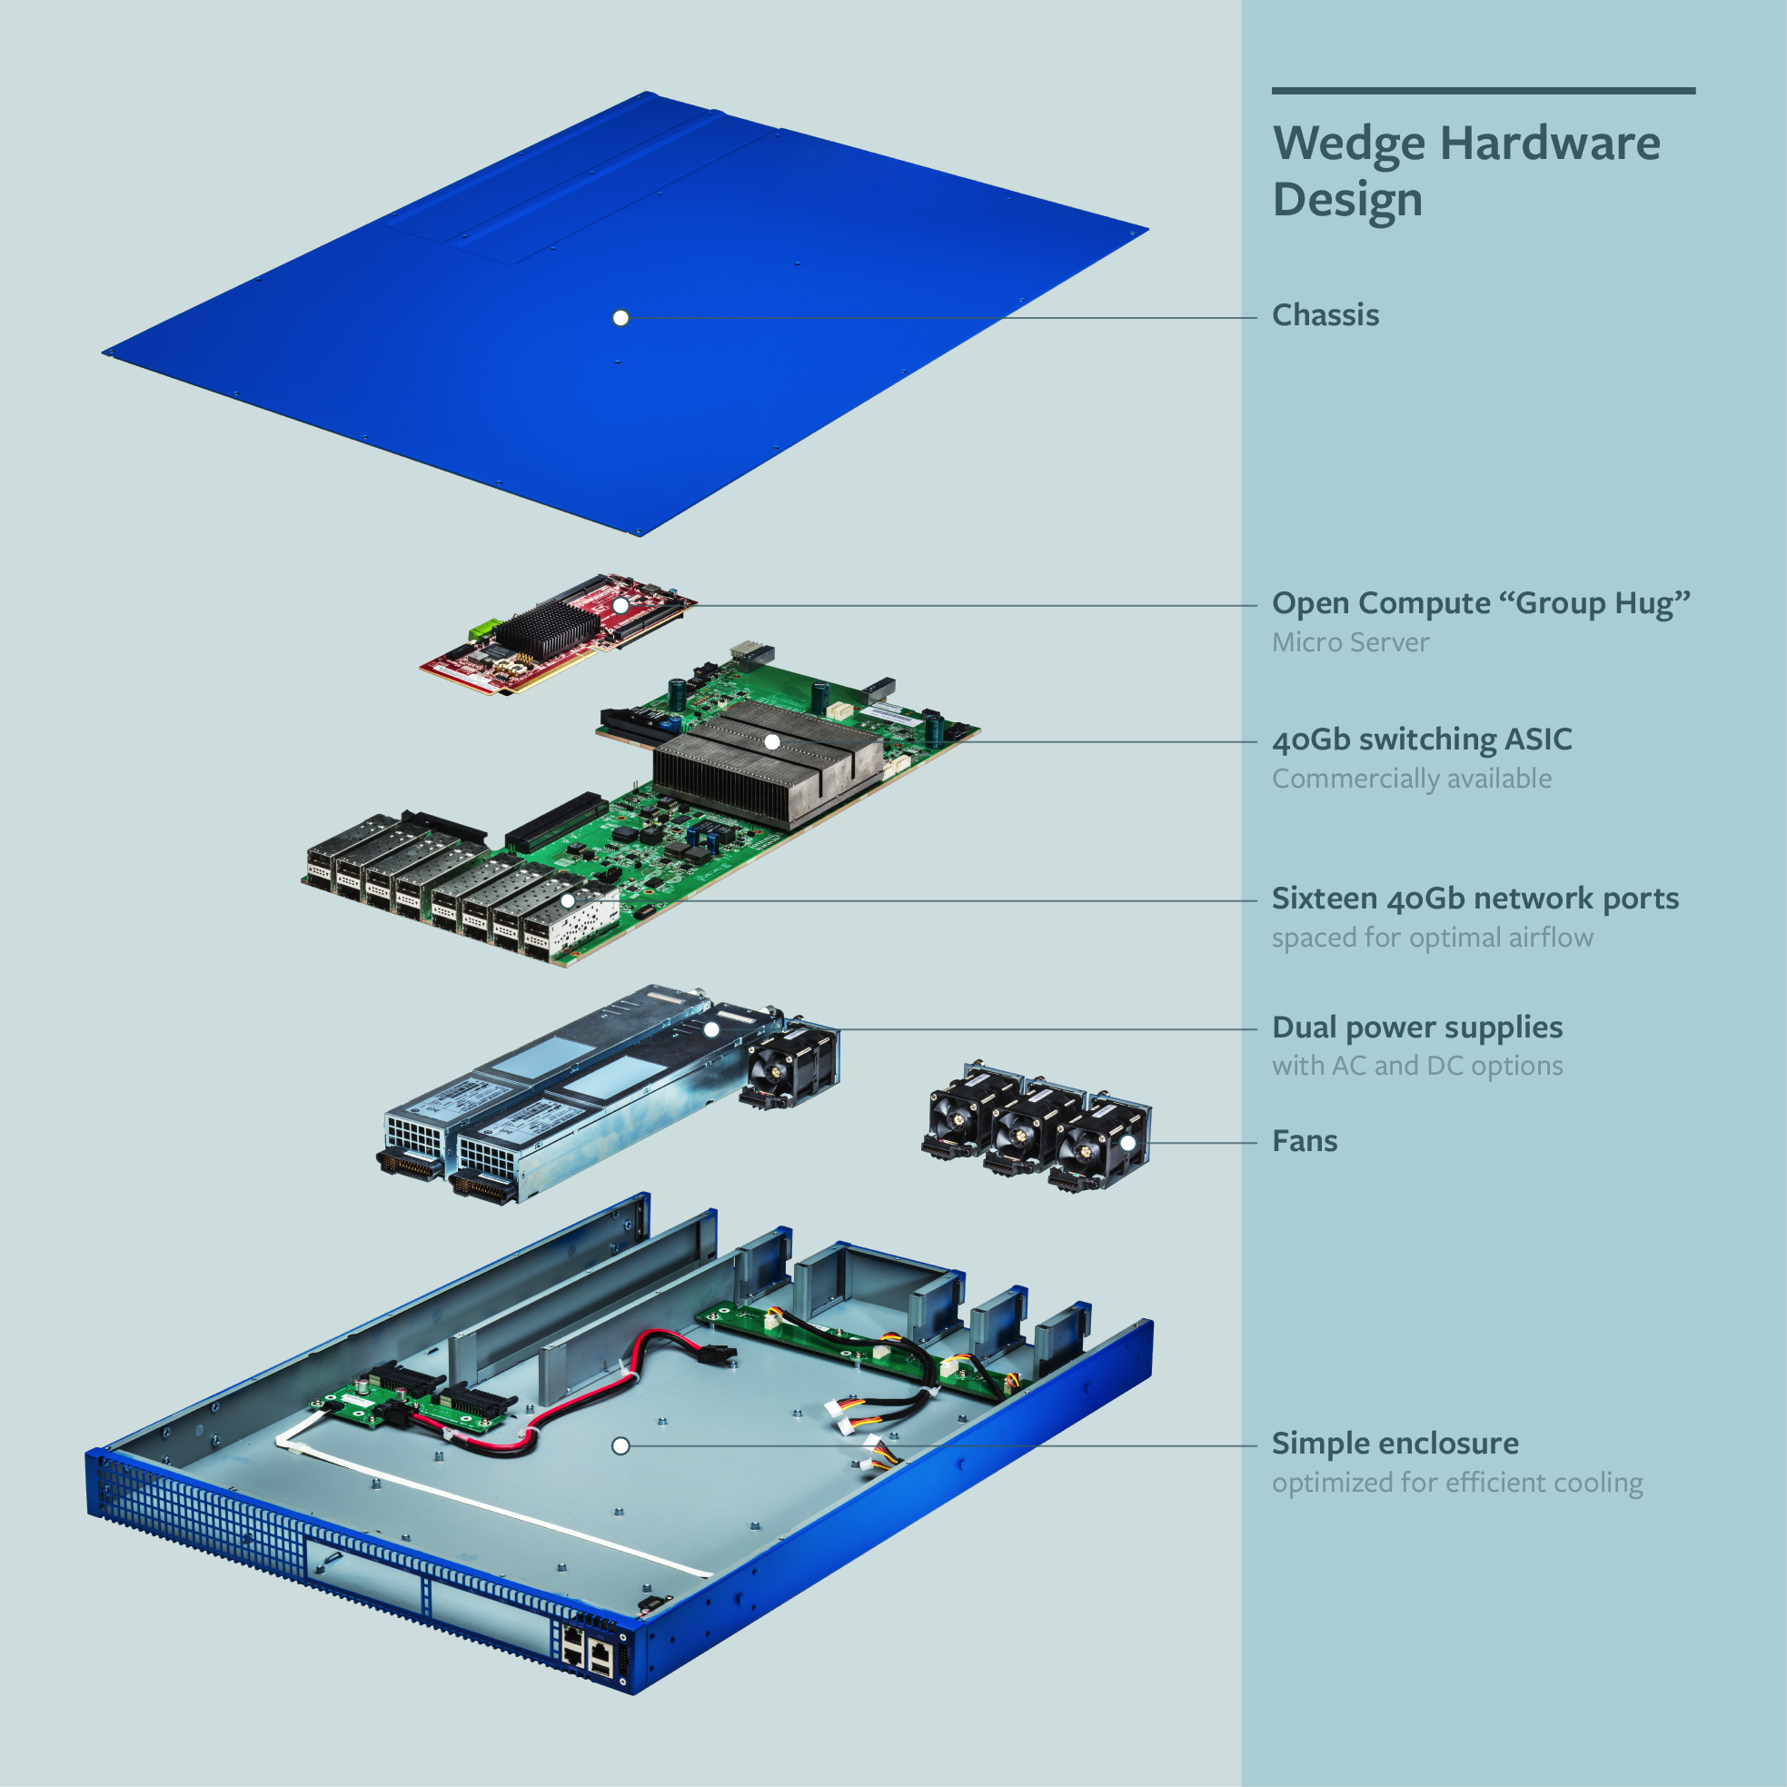
OCP: Wedge switch (open-source design)
BCM xChip: 1.2Tb/s

Slide 38

Bare-metal Switch Software
Environment
Agent
Forwarding
Agent
Open-source
FBOSS, OVS,
Switch Light,
Indigo.
Open-source
ONL
Switch OS
Open-source
ONIE
Boot Loader
Config
API/Driver
Open-source
OF-DPA
CPU
Fans, connectors, power supply
Switch
Chip

Slide 39
Will switches be hardware or software?

Slide 40
Packet Forwarding Speeds
Programmable,
open
Fixed, closed
Fixed/microcoded
3.2Tb/s
Gb/s
(per chip)

Slide 41
Packet Forwarding Speeds
Programmable,
open
Fixed, closed
Fixed/microcoded
3.2Tb/s
50x
Gb/s
(per chip)

Slide 42
Switches will be built from programmable ASICs

Slide 43
Open-source
ONOS, ODL
NOX, POX, Ryu
Floodlight, Beacon
(Remote) Network Controller
Optional Remote API
Environment
Agent
Forwarding
Agent
Open-source
FBOSS, OVS,
Switch Light,
Indigo.
Open-source
ONL
Switch OS
Open-source
ONIE
Boot Loader
Open-source
P4
Config
API/Driver
Open-source
OF-DPA
CPU
Fans, connectors, power supply
Switch
Chip

Slide 44
System Management
Routing, Traffic Engineering,
Mobility, VPN
DPI, Load Balance, SPAM
New Services
Proprietary
Software
Network OS (SDN, NFV, …)
Open Source
Software
Linux
Linux
Linux
Linux
Linux
Programmable
Hardware
Server
Switch
Radio
PIC
VM

Slide 45
What just happened?
Rise of Linux.
Rise of merchant switching silicon.
Slow glide of box vendors to irrelevance.
Network owners just got handed the keys!

Slide 46
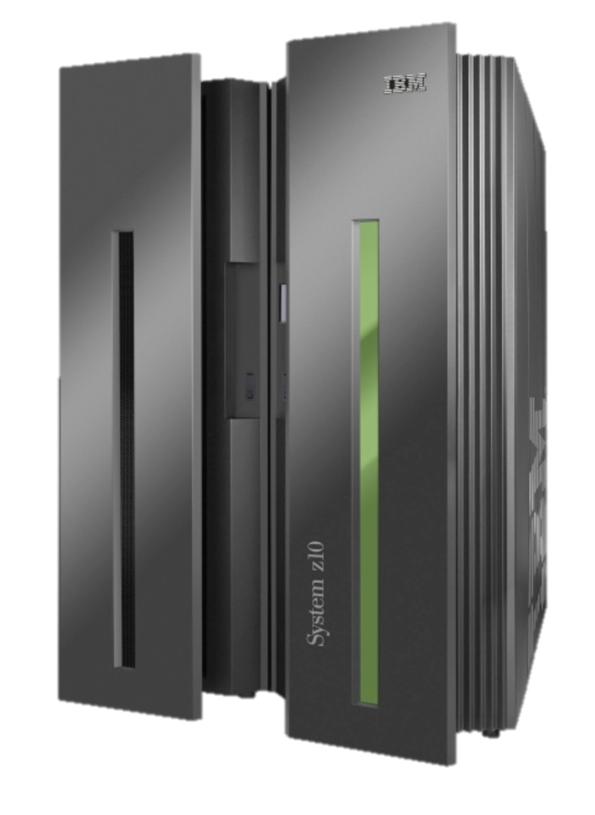
Computer Industry
App
App
App
App
App
App
App
App
App
App
App
Specialized
Applications
Open Interface
Specialized
Operating System
Windows
(OS)
Linux
Mac
OS
or
or
Open Interface
Specialized
Hardware
Microprocessor

Slide 47
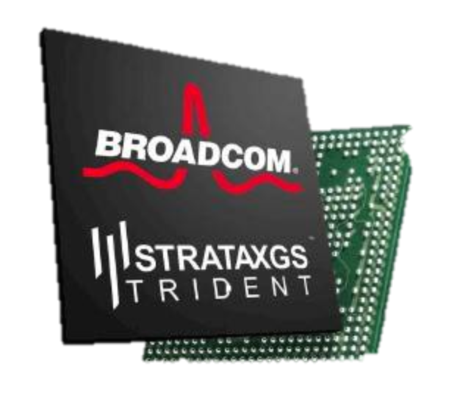
Networking Industry
App
App
App
App
App
App
App
App
App
App
App
Specialized
Features
Open Interface
NOX
Beacon
ONIX
POX
ONOS
Flood
light
Trema
ODL
Ryu
Control
Plane 1
Control
Plane 2
Specialized
Operating System
Open Interface
Switch Chips
Specialized
Hardware

Slide 48
“Because there is no army that can hold back an economic principle whose time has come.”
John Donovan, AT&T

Slide 49
Summary
Network infrastructure will be:
  Proprietary software (to differentiate)
  Open-source software infrastructure
  Programmable hardware substrate
Existing box vendors will turn into software vendors,
or they will be irrelevant (and disappear)

Slide 50
Three consequences of SDN
Virtualized networks:
Already started to happen (the “killer app”)
More programmable networks:
New programmable forwarding devices
More reliable networks:
“Top down” programmability enables formal network verification

Slide 51
Even simple questions are hard
Can host A talk to host B?
What are all the packets from A that can reach B?
Are there any loops in the network?
Is Group X provably isolated from Group Y?
What happens if I remove a line in a config file?

Slide 52
More interesting questions
When I add a new forwarding rule, how can I dynamically check in real-time if it will violate my network policy?
How do I track down the source code that was the root cause of a data plane error?
If switch hardware is malfunctioning, how will I know? How will I identify the switch/rule?

Slide 53
Neither observe nor control
Complex interaction
  Between multiple protocols on a switch/router.
  Between state on different switches/routers.
Multiple uncoordinated writers of state.
Network owner can’t…
  Observe all state.
  Control all state.

Slide 54
Header Space Analysis:
Modeling Forwarding Behavior

Slide 55


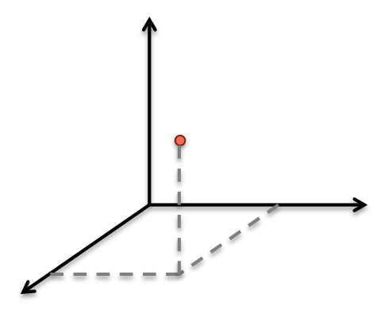
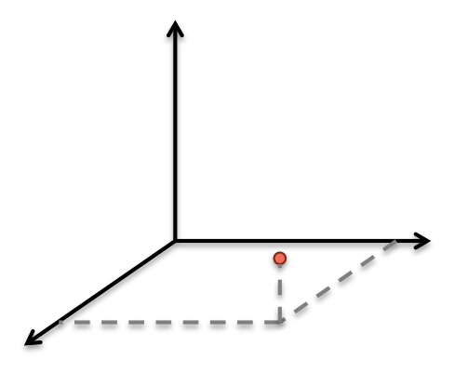
Header Space Analysis
[NSDI ‘12]
A
Header
B
Data
Header
L
Data
01110011…1
111..100000

Slide 56
Header Space Analysis
Match + Action
1
2

Slide 57
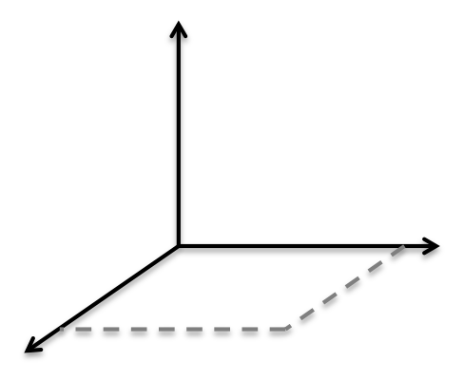
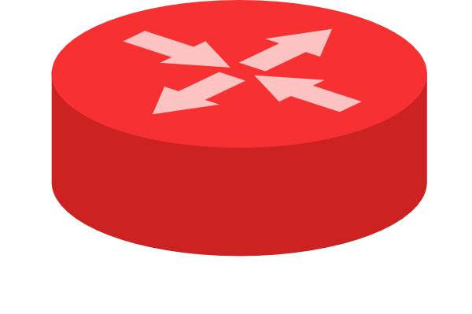
The set of packets from A that can reach B
A
B

Slide 58
All packets from A that can reach B
A
B

Slide 59
Implications
Reachability and loops
Prove two groups are isolated
Regardless of protocol or layer
Analogy to Boolean algebra
Follow-on
  NetPlumber: Dynamic checking for Google’s OpenFlow WAN 10,000 times per second
  ATPG: Testing every forwarding rule 10-times per second

Slide 60
<The End>

